Slide 1
VL Cascade on Tier.net
Preparing a list patients who are potentially eligible to be decanted
NB:
Appearing on the list does not translate to enrolment, this only gives you a list of patients who qualify based on 2 Viral Loads.
The clinician may find the patient does not currently meet all enrolment criteria and might still exclude the patient
The file must be pulled out, we might also realise that the patient has been missing appointments.
Patients might still opt out

Slide 2
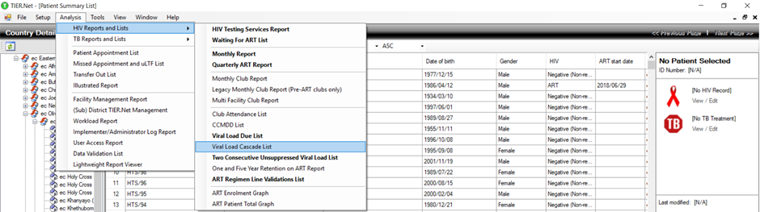
In Tier.net, produce the Viral Load Cascade List
Analysis Tab → HIV Reports and Lists → Viral Load Cascade List

Slide 3
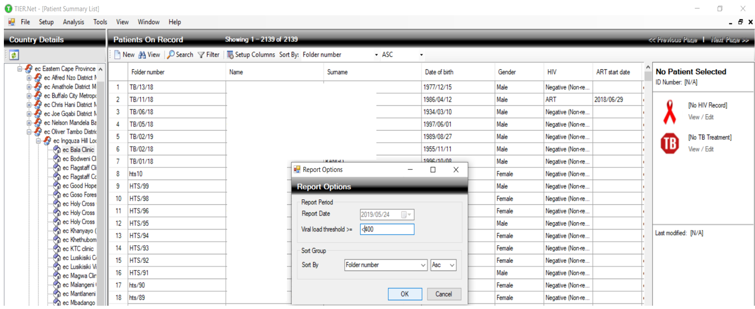
Limit viral load threshold to <400
Report Options → Viral load threshold → <400

Slide 4
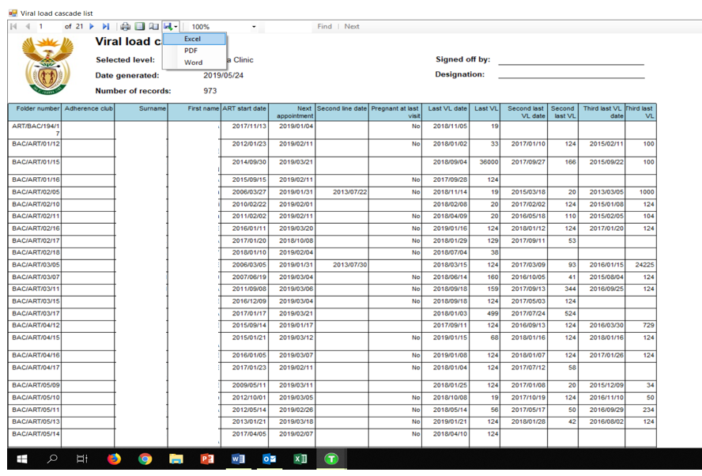
Export to Excel
Viral lad cascade list → Download Icon (Floppy disk with green arrow) → Excel

Slide 5
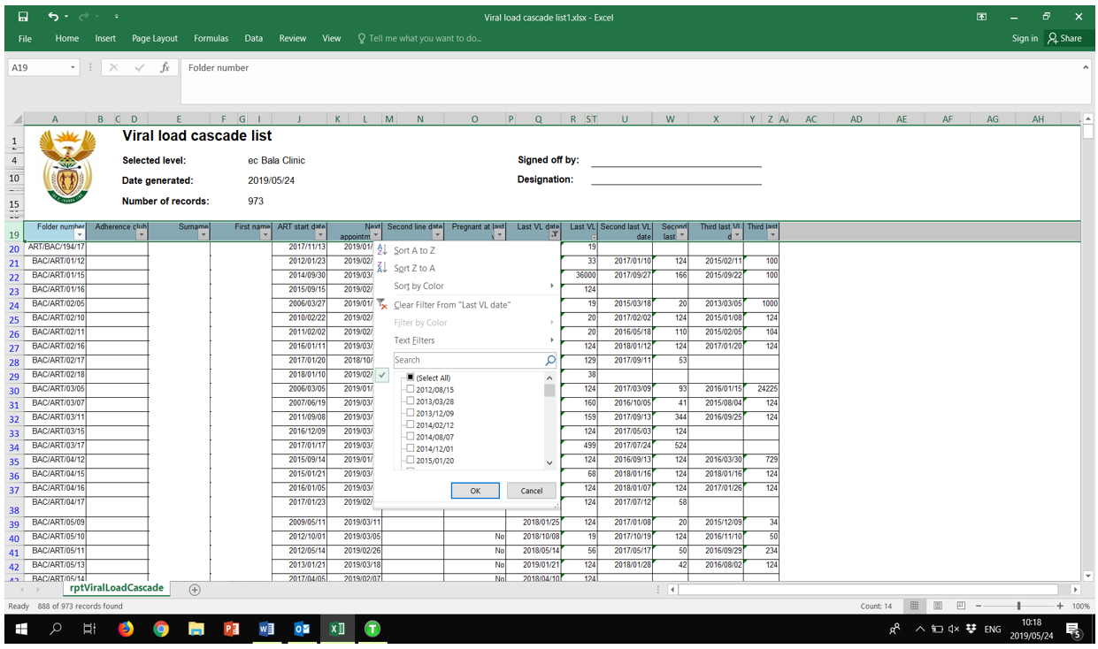
Activate filters, remove all the late VL
Last VL date column → Uncheck dates more than 6 months from today’s date

Slide 6
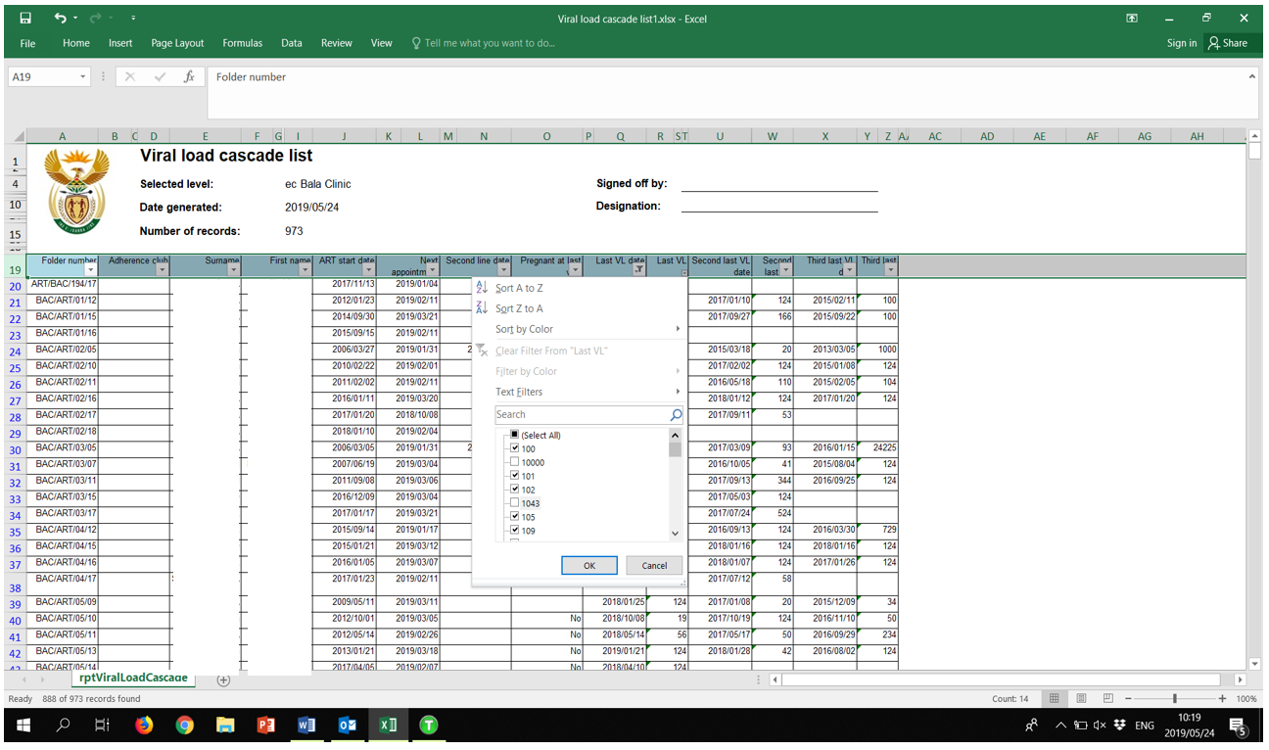
On Last VL column, remove all the VL >400 and Blanks
Last VL column → Uncheck all values greater than 400 and uncheck “Blanks” value

Slide 7
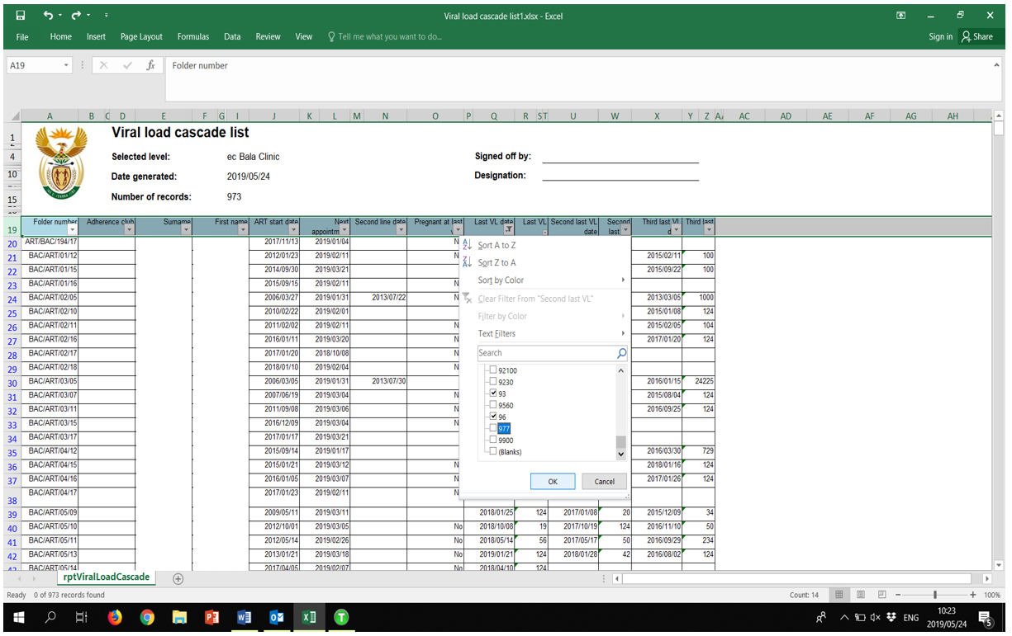
On Second Last VL column, remove all the VL>400 Blanks
Second Last VL column → Uncheck all values greater than 400 and uncheck “Blanks” value

